Slide 1
Cornwall College
Foundation Learning

Slide 2
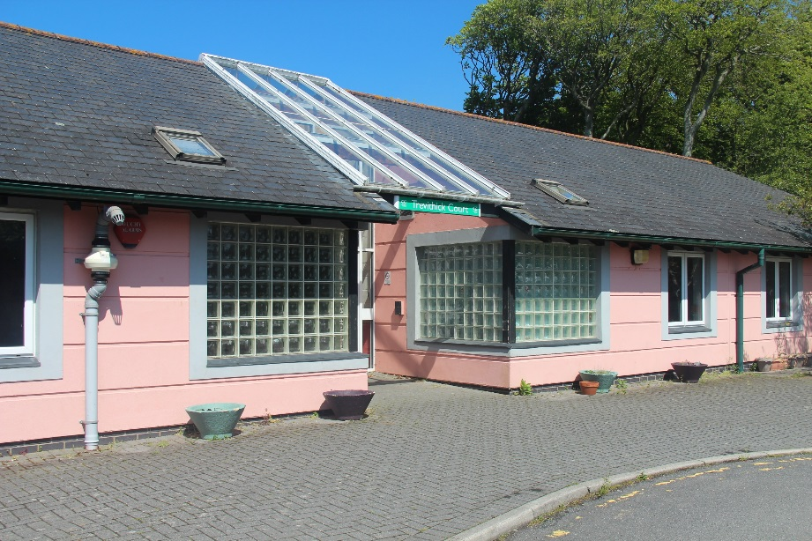
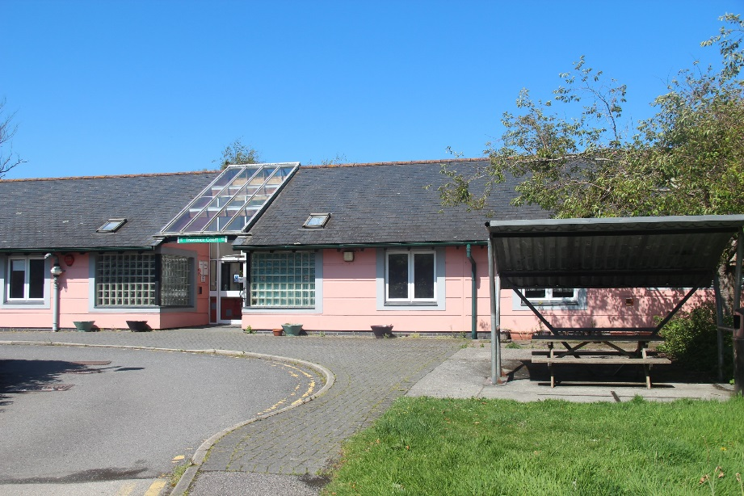
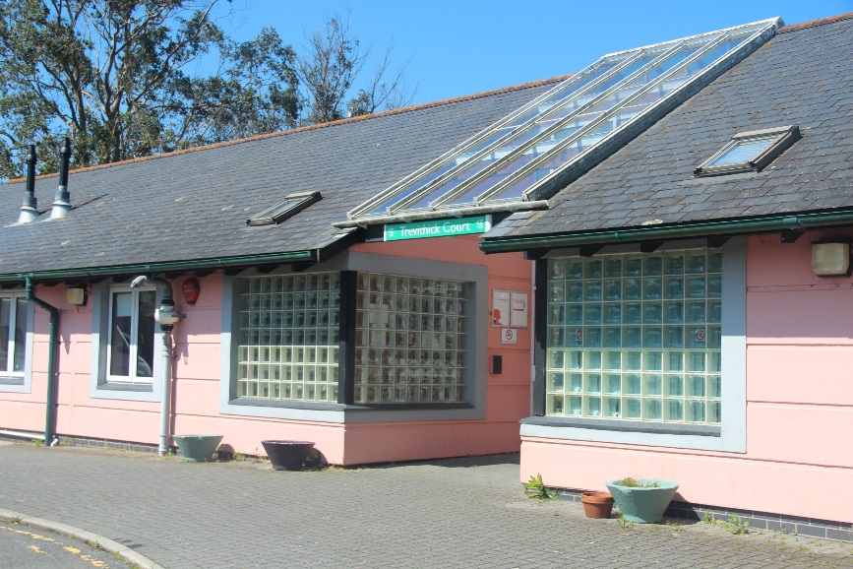
Welcome to Trevithick Court

Slide 3
Trevithick Court
Purpose built building for Foundation Learning
2 Fully Operational Kitchens
Independent Living Suite
Art Room
2 Computer Rooms
Quiet Room
Sensory Room
Outside Gardens
Easy Access to Other Building Across the College
Lets look at other builds you may use while at College ……………

Slide 4
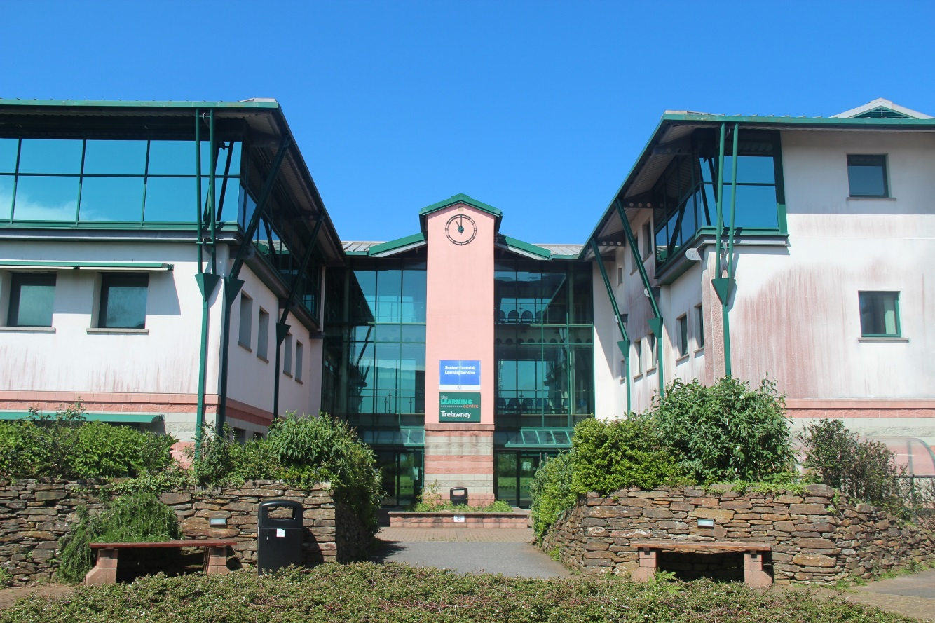
Trelawney Building
Library Computer Rooms
Student Union The Hub Shop
Student Services Vocational Studies

Slide 5
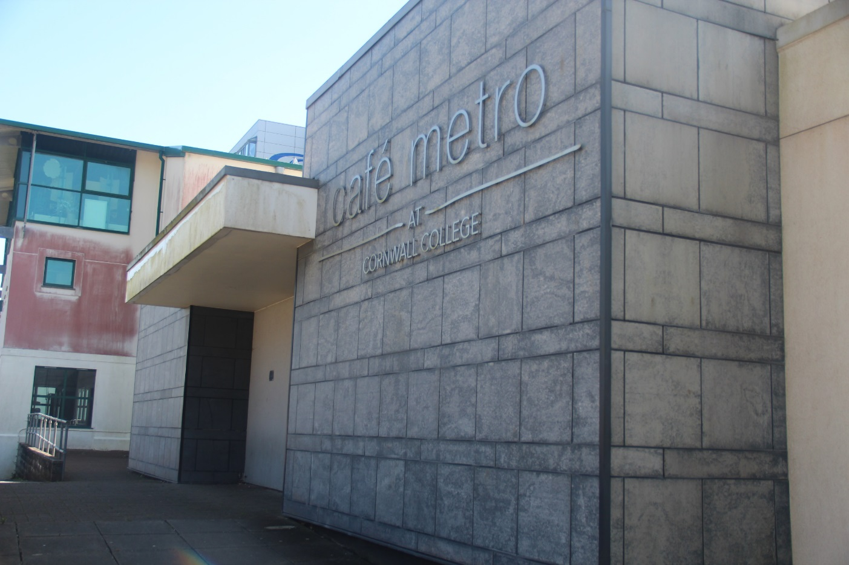
Café Metro
Student Café
Brea Coffee shop
Quiet Area

Slide 6
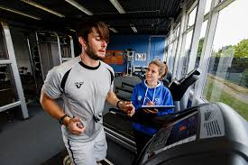
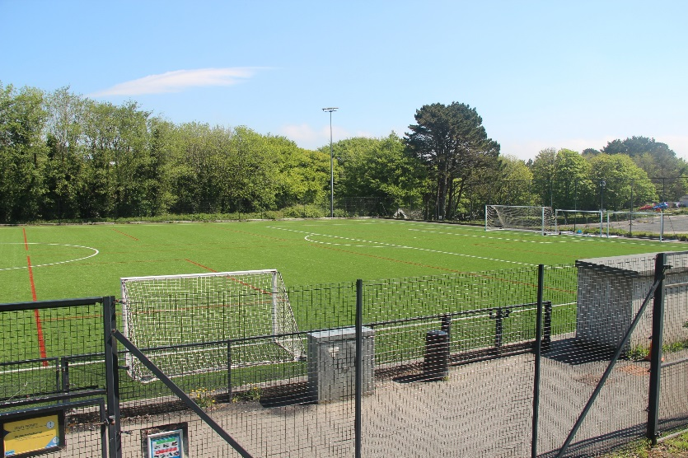
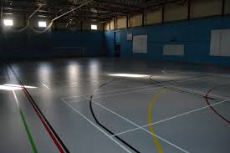
Sports Hall
Sports Hall
Fitness Astro Pitch

Slide 7
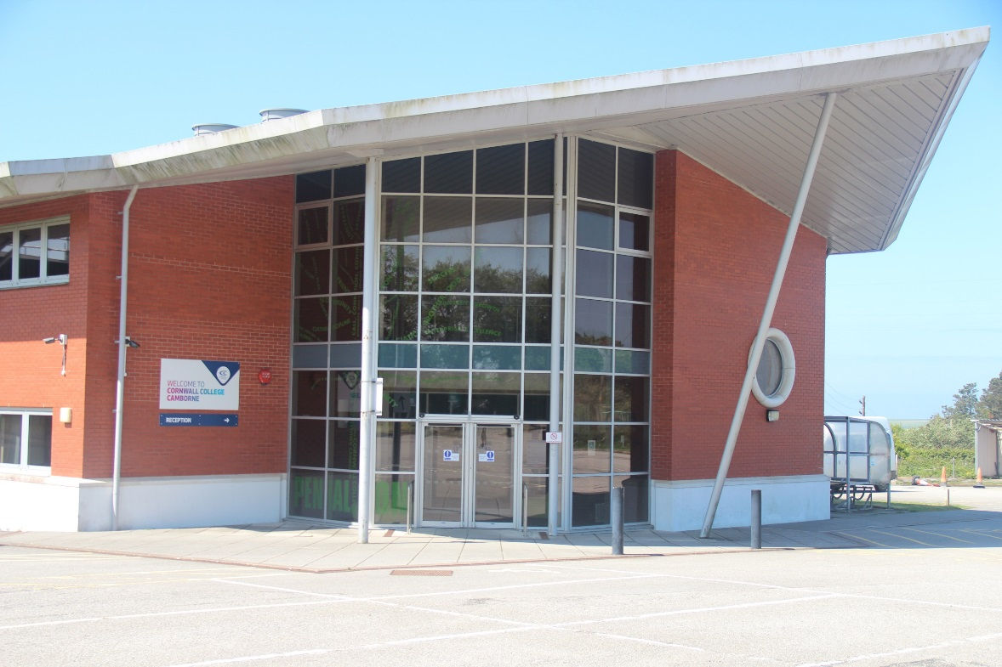
Penhaligon Building
Main Reception
Student Central
Head of College

Slide 8
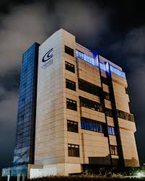
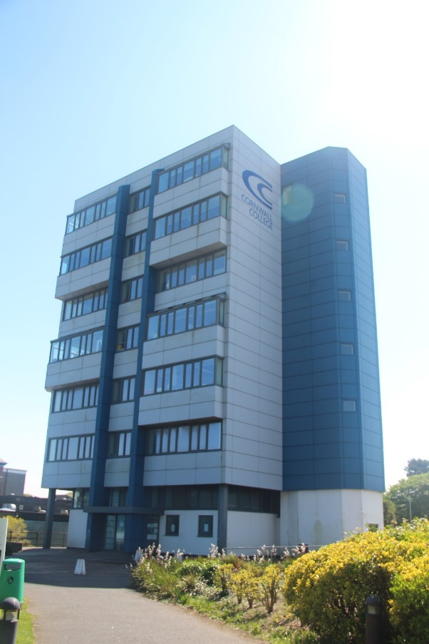
Tamar Building
Art & Design
Media Studies
Photography

Slide 9
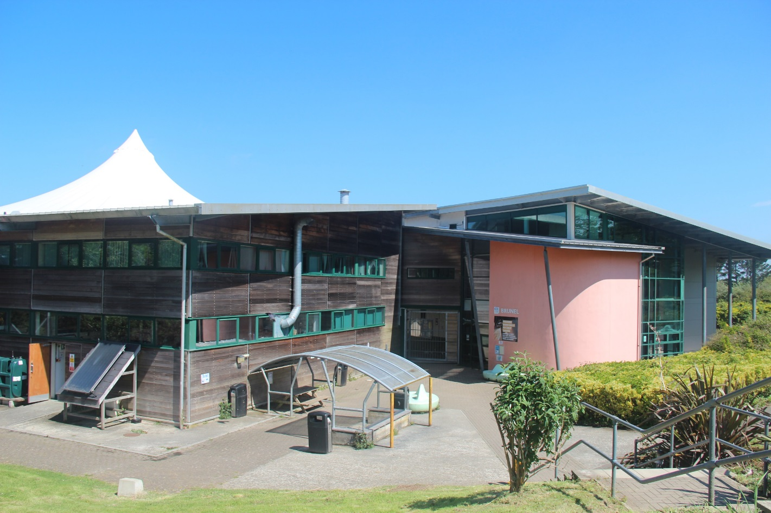
Brunell Building
Motor Vehicles
Engineering
Construction

Slide 10
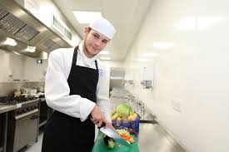
Carlyon Building
Hair & Beauty
Koko Salon
Catering
Trevenson Restaurant

Slide 11
