Slide 1
Lenses
Field of View and Perspective

Slide 2
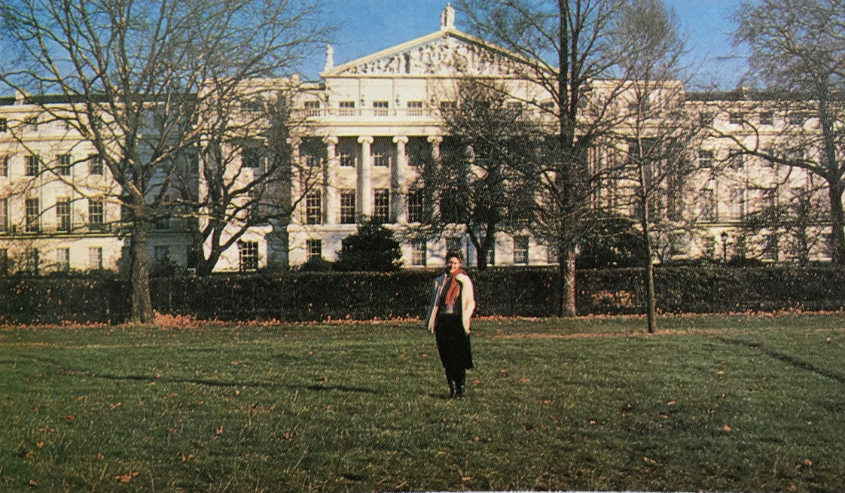
Comparing Perspective
Keeping Subject the Same Size
28mm / 18mm Lens Setting
50mm / Your View

Slide 3
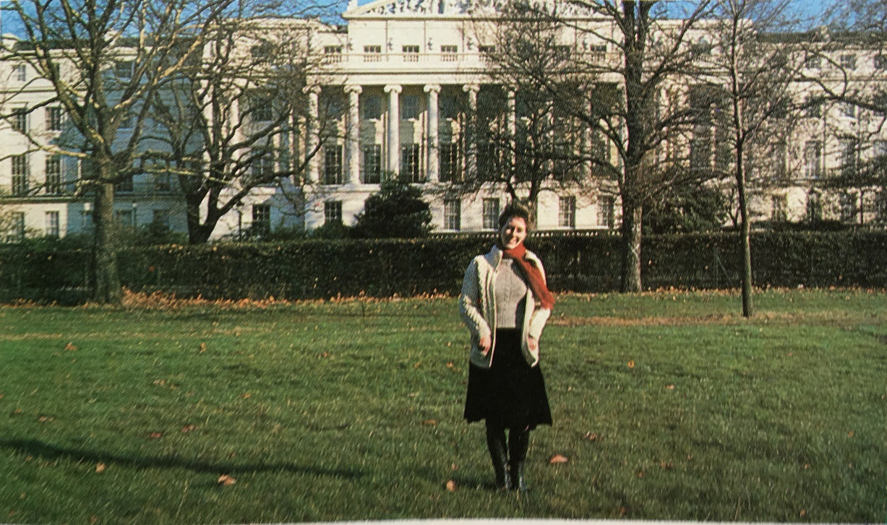
Comparing Perspective 2
50mm/35mm Setting
Your View

Slide 4
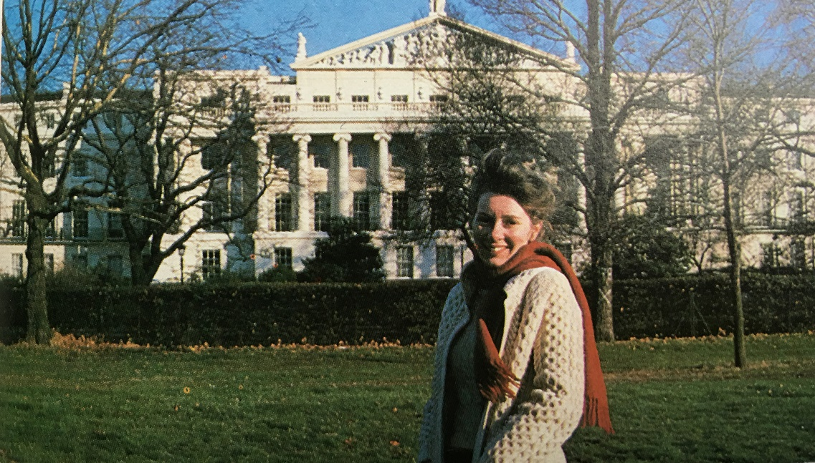
Comparing Perspective 3
135mm/90mm
Your View/50mm

Slide 5
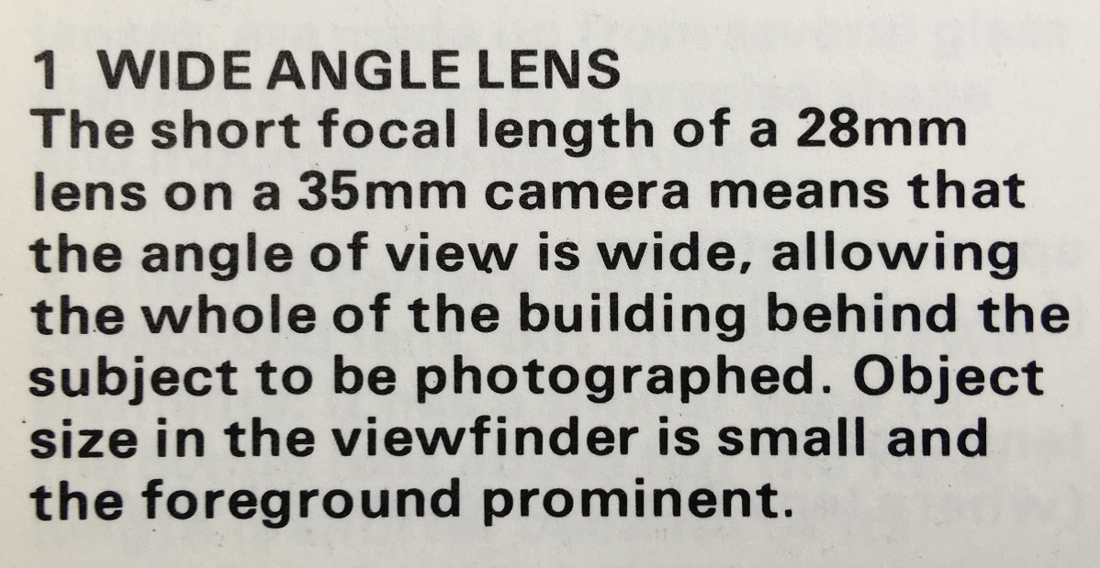
Perspective 4
28mm Equivalent to 18mm on APS-C

Slide 6
Perspective 5

Slide 7
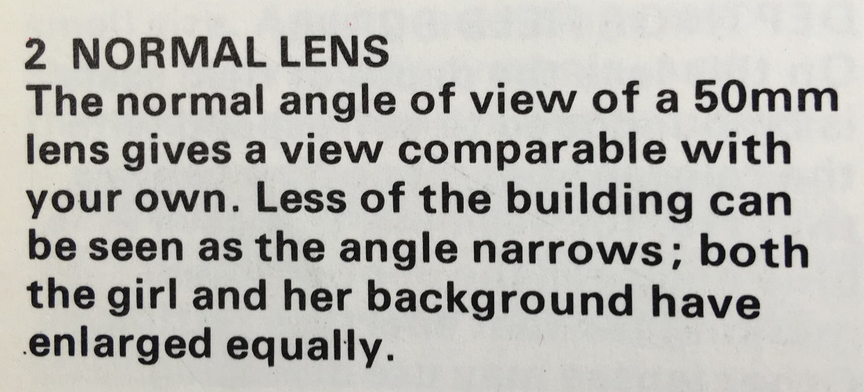
Perspective 6

Slide 8
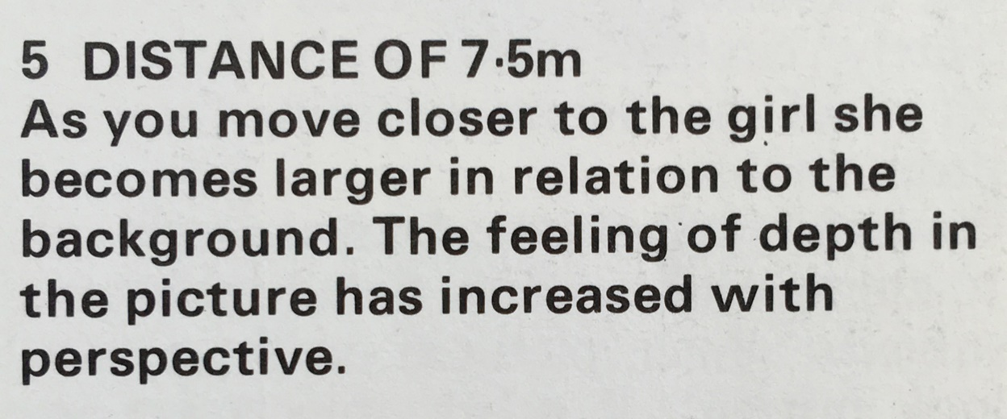
Perspective 7

Slide 9
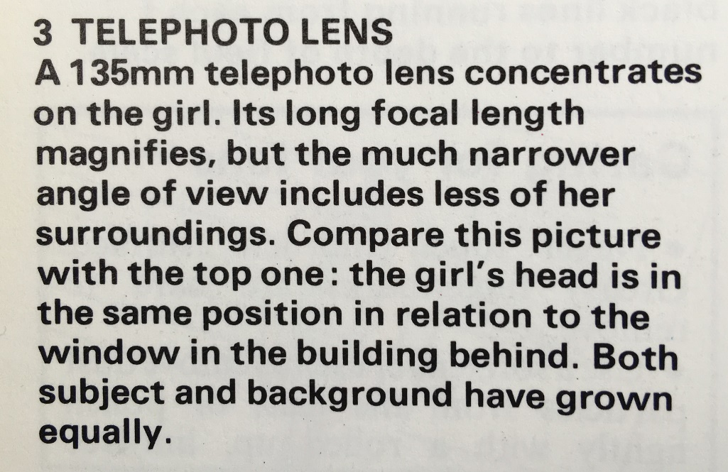
Perspective 8

Slide 10
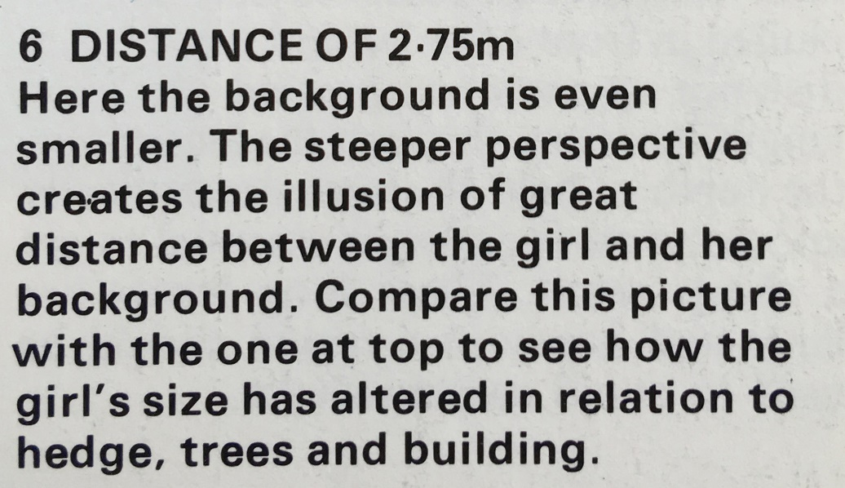
Perspective 9

Slide 11
Your Normal View

Slide 12
8mm/6mm

Slide 13
20mm/14mm

Slide 14
35mm/18mm

Slide 15
50mm/35mm

Slide 16
85mm/55mm

Slide 17
135mm/90mm

Slide 18
300mm/200mm

Slide 19
1000mm/670mm

