Slide 1


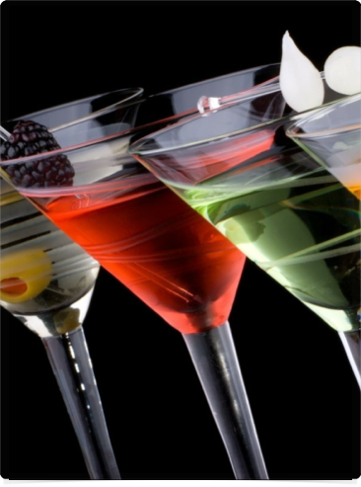












MACRO PHOTOGRAPHY

Slide 2

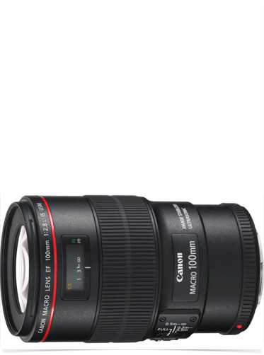




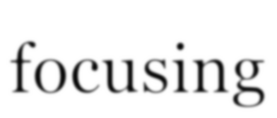





MACRO LENSES
designed for close-up work
with a long barrel for close focusing
optimized for high reproduction ratios
Canon Macro 100mm f28

Slide 3

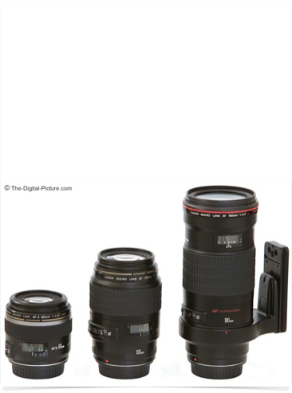

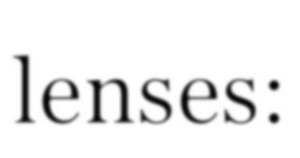






FOCAL LENGTH

Slide 4

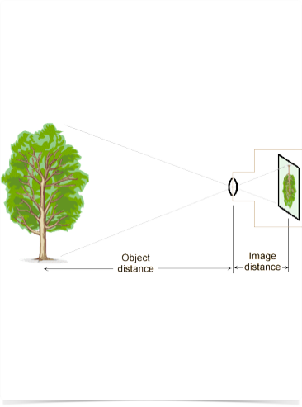







FOCAL LENGTH
The distance from the lens to the sensor, when focused on a subject at infinity.
focal length equals image distance for a far subject.
To focus on something closer than infinity, the lens is moved farther away from the sensor. This is why most lenses get longer when you turn the focusing ring.
The distances follow this formula:

Slide 5


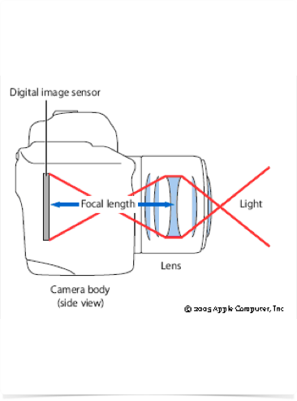











TELEPHOTO
This means a 400mm lens should be 400mm long.
If you get out your ruler and
measure it, you will find it is less than 400mm.
That is because a camera lens really has many individual glass lenses
inside, and this makes it behave as if it is longer than it really is.
This is called "telephoto."

Slide 6






F/STOPS
F-stop is the focal length divided by the diameter of the lens. For example, a 200mm f/4 lens will be 50mm wide.
Get out your ruler and measure it.
200mm/50mm = f/4.
That is why f-stop is typically written as F/4, meaning "focal-length over 4" or "focal-length divided by four”.
Lenses are marked with a series of f-stops, each one lets in half as much light as the previous one.
The light-gathering ability of a lens is determined by its area, and f-stops are determined by diameter. Area is related to diameter squared. The progression of f-stops, 1 - 1.4 - 2 - 2.8 - 4 - 5.6 - 8 - 11 - 16 - 22 - 32, are powers of the square root of 2.

Slide 7
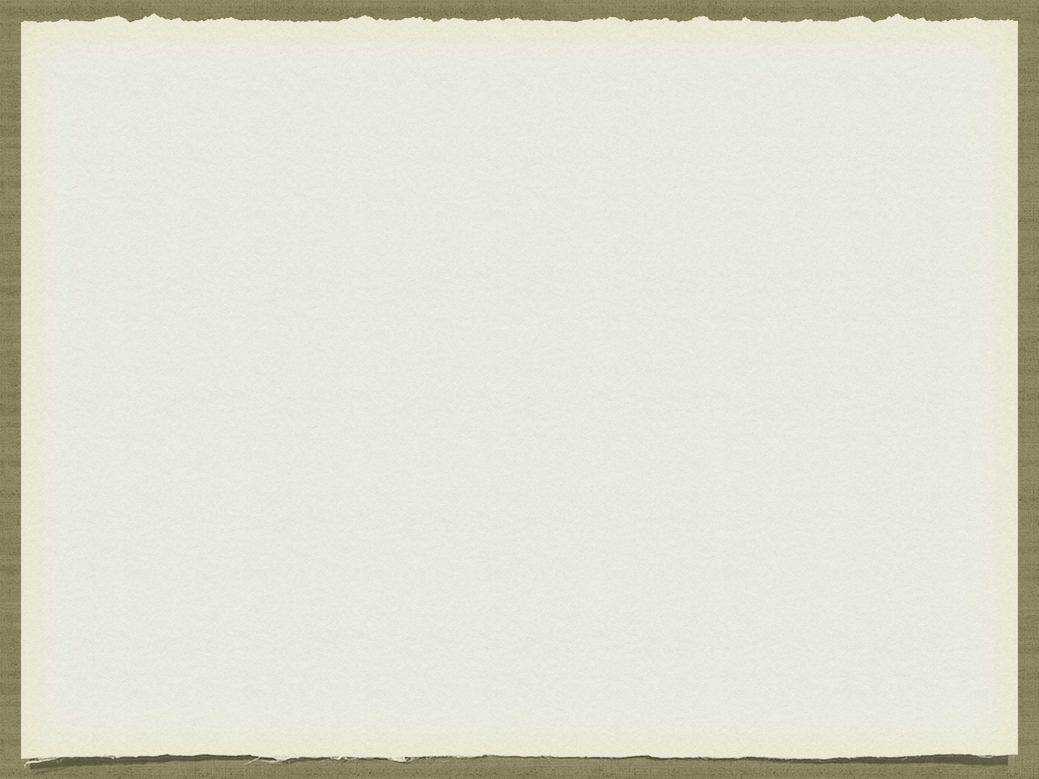

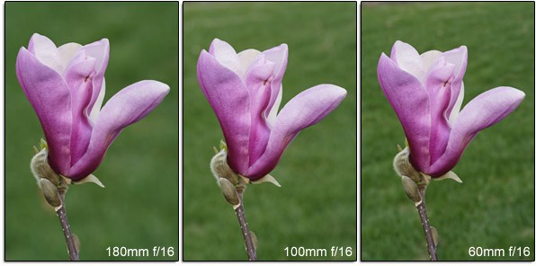
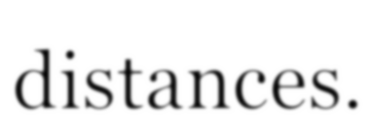
Background Blur Comparison
Same aperture setting (f/16) and identical subject to background distances.

Slide 8







FOCAL LENGTH

Slide 9
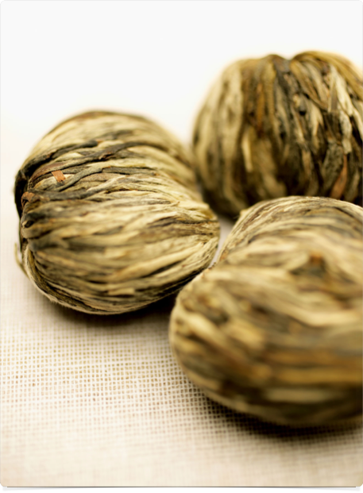
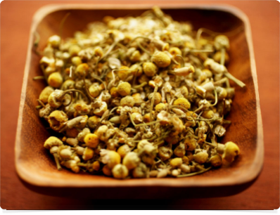


Slide 10
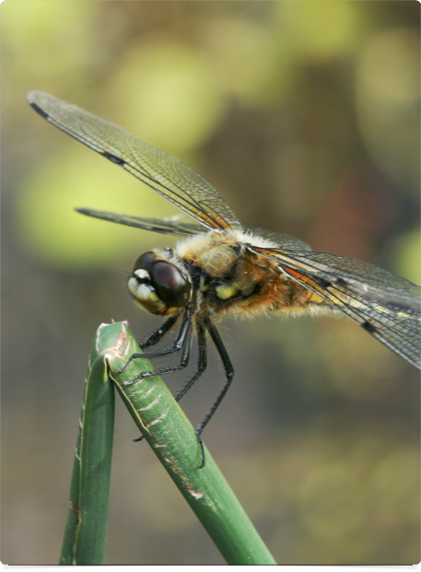
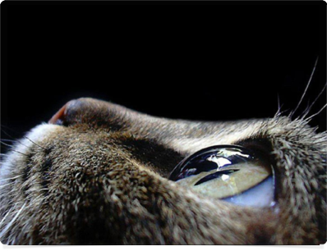
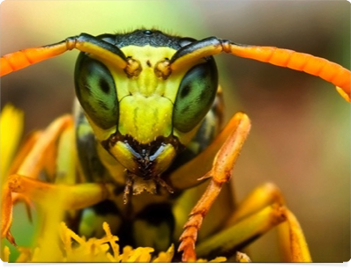

Slide 11
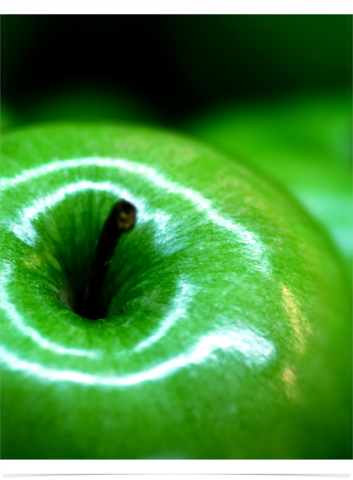
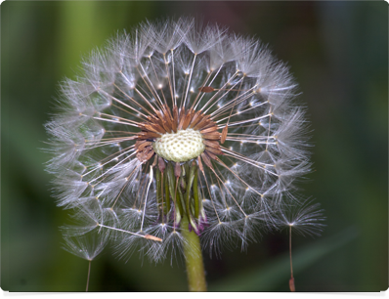
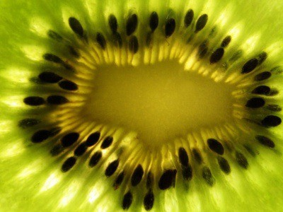

Slide 12
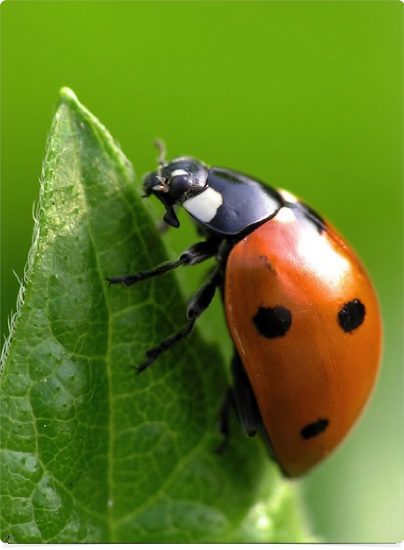
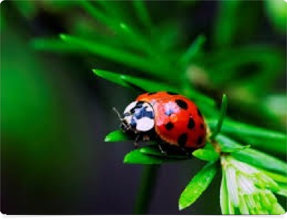
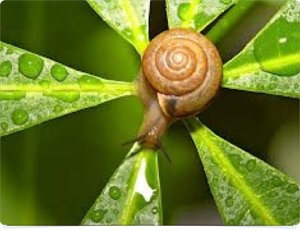

Slide 13
