Slide 1
The Art of Product Photography
10 tips to eﬀective product photography

Slide 2
Introduction
Having a great product and showcasing a great product are two diﬀering verbs. The diﬀerence is in the portrayal of the product be it in use or placement. Over the years, product photography has become an essential part of any branding exercise and is crucial to the reach and success of the same.
Here are a ten tips to sail you through eﬀective product photography.

Slide 3
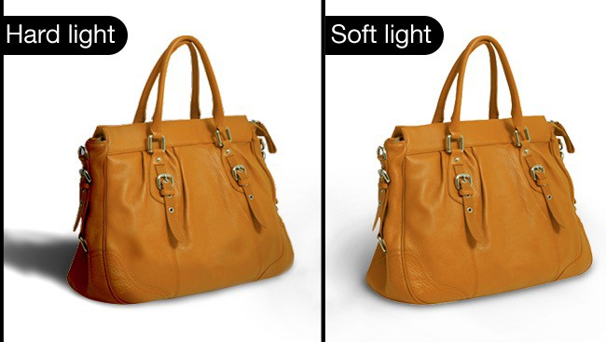
Get lots of light
Natural light
works best for any
type of photo and should be used whenever possible. Typically, shooting your photos during the day will grant the best results. What matters is not only the quantity of the light, but the uniformity of distribution as well.

Slide 4
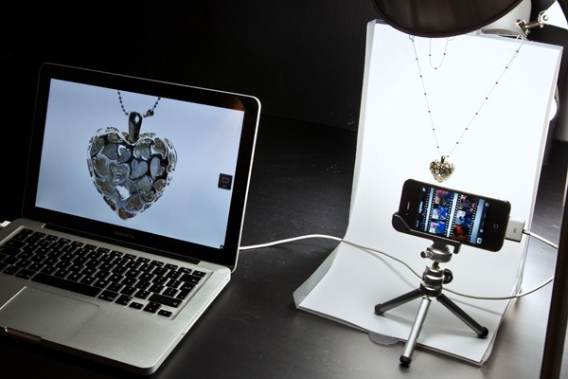
White Background
Often in product photography, a clean white background looks best
since it object
creates a
focus on the The “Infinity
itself.
Curve” to shoot
enables photographers
products against an endless white background that reveals no horizon in the back, only a clean and pleasant view.

Slide 5
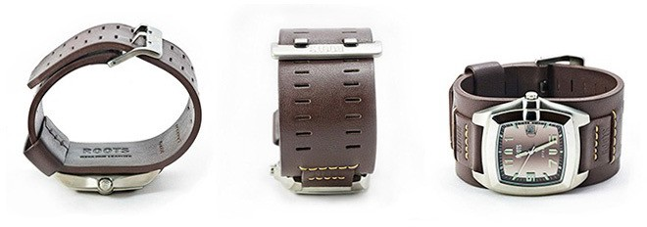
Unusual Point of View
As you take photos, go for unusual angles, get close ups and look for unique points of view. Tell
a story
with while
the images you you
capture,
accentuate
particular angles.

Slide 6
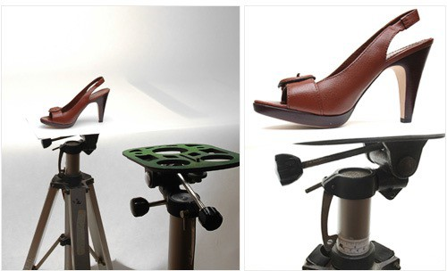
Use a Tripod and a Timer
A tripod will assure you remain stable as you take the photo. Even an inexpensive tripod will make a big diﬀerence in the sharpness of your images. Additionally, you can use the camera’s built-in timer to minimise camera shake and maximise accuracy.

Slide 7
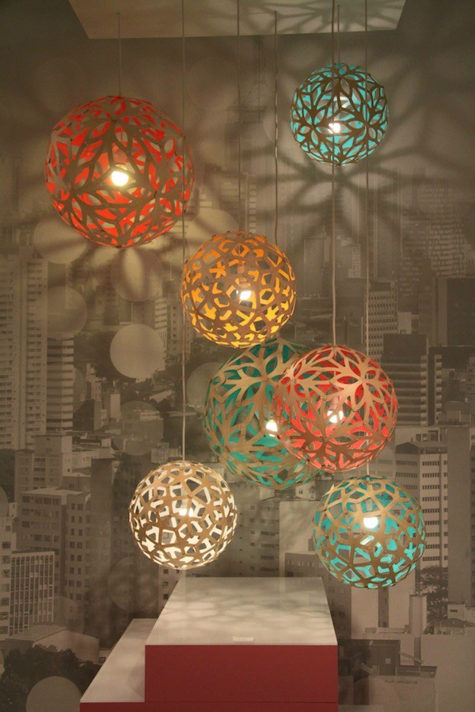
Sense of Scale
If you
include
an item in the are
image
that people
familiar
with, it can really help to visualise
the size
of the product. For if the product is a
example,
miniature doll, you could place an object like a standard sized pencil next to it, and give people a sense of scale.

Slide 8
Product in its Natural Environment
Take pictures of your product next to an item that will help people relate to it in real life. Potential buyers will get an idea of how the item will look on them and also, it could show the type of target audience you’re aiming for.

Slide 9
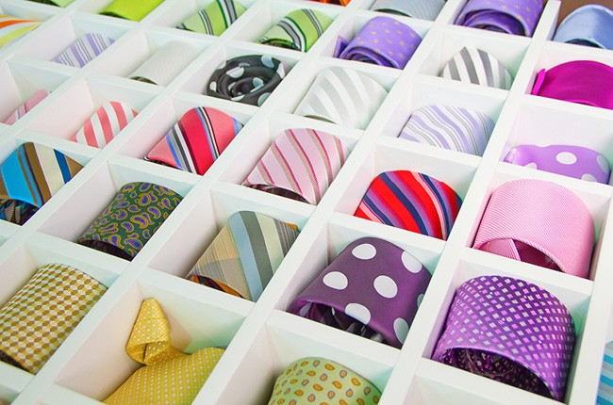
Let the colours talk
A set of
photos showing the
variety of colours will make the
product look
richer
and more tell them
attractive. Don’t
just
about it, let people
see for
themselves.

Slide 10
Don’t Delete from Camera
Don’t get tempted to make quick verdicts about your pictures when you review them on the camera.
Be patient
and wait the photos
until you to your very
download computer.
Images look
diﬀerent on a bigger screen.

Slide 11
Use the ‘Flower’ Setting
Most cameras have a “close-up” setting that you switch it to when
you are
taking a closer than photo. The “flower”
standard
setting is really called “Macro” and it appears on most cameras as a tulip-like icon.

Slide 12
Editing Is Important
Taking a shot is often just the beginning, next comes the editing and the touch ups. As you prepare images for your site, make sure they are approximately the same size. Choose 1-3 diﬀerent sizes from large to medium and small.

