Slide 1
Product Photography

Slide 2
Agenda
1
2
3
4
5
6
7
8
What is product photography?
DIY product photography
Why is it important?
Optimize your photos for Shopify
Types of product photography
Further resources
Common photography mistakes
Q & A

Slide 3
What is product photography?

Slide 4
The art of taking photos that best represent your product in an accurate and attractive manner

Slide 5
Why is it important?

Slide 6
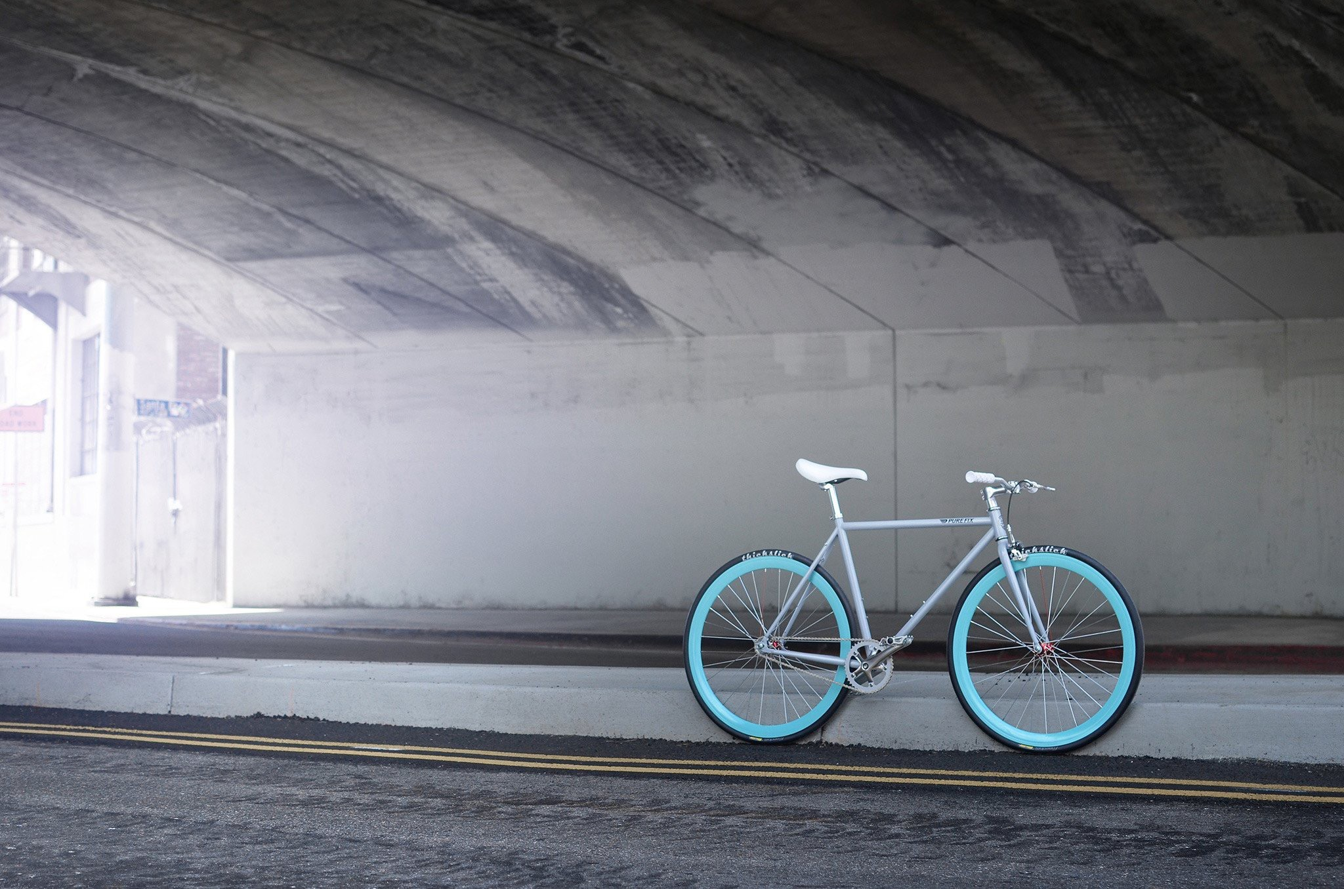
Why is great product photography important?
Can make or break your business
Closest thing to customer touching/ feeling the product
Allows the customer to picture your product fitting into their life
Sets your store apart from others
Catches visitor’s attention and keeps them from leaving your store

Slide 7
Types of product photography

Slide 8
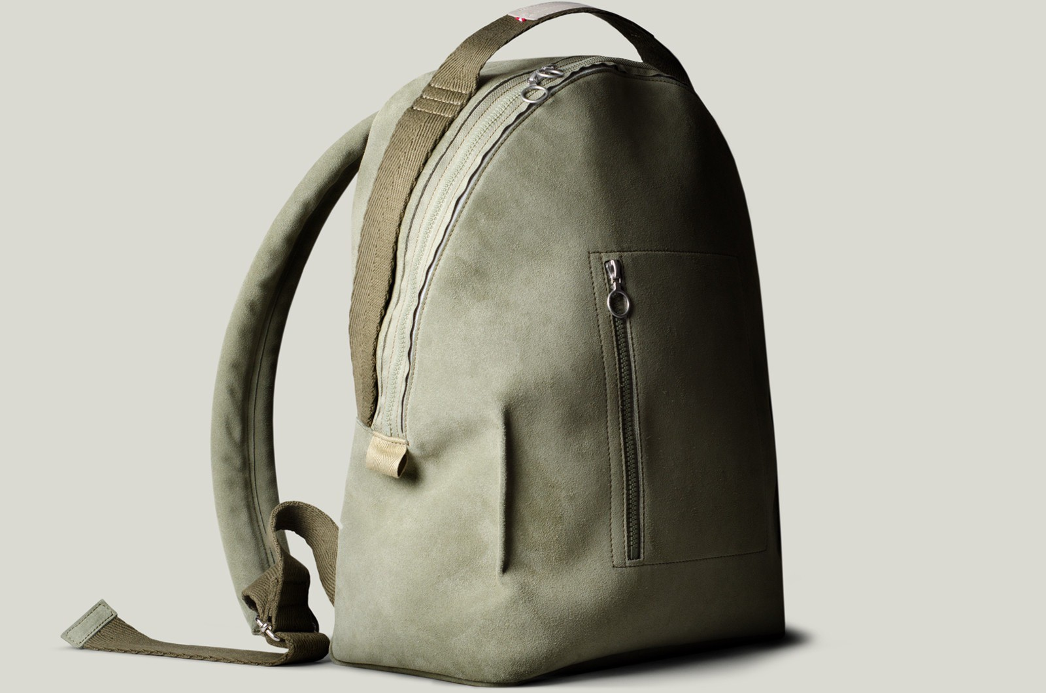
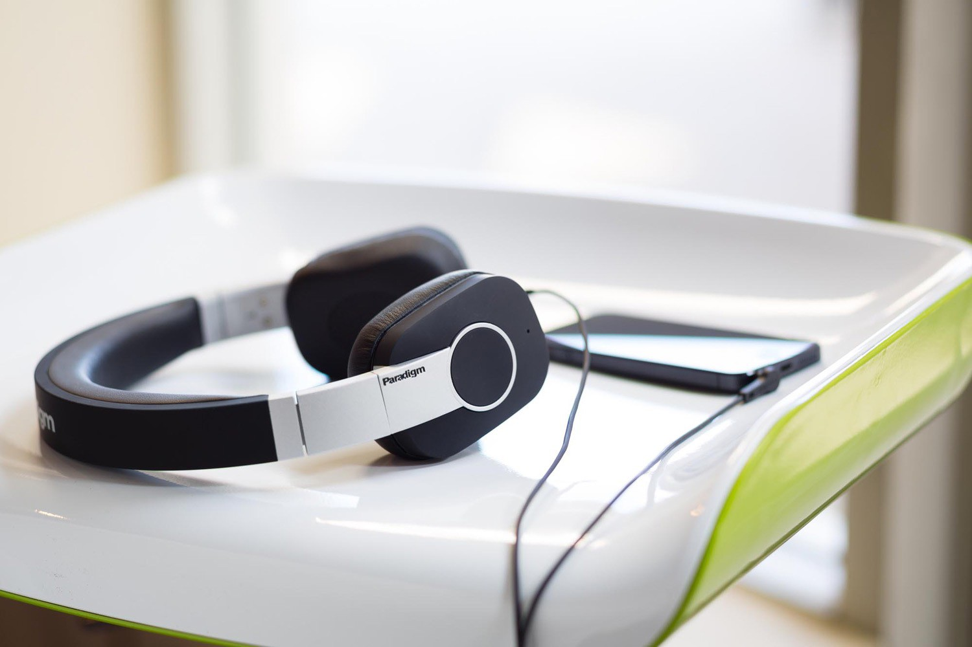
Traditional vs. lifestyle product photography
Traditional product photography
Lifestyle product photography

Slide 9
Common product photography mistakes

Slide 10
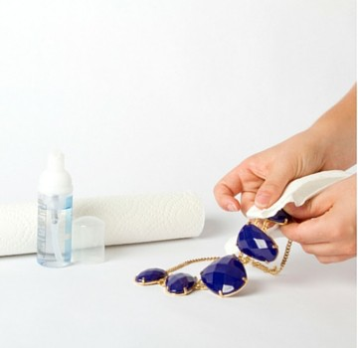
Crucial product photography mistakes
NEGLECTING TO PREPARE YOUR PRODUCTS
This may seem obvious, but you should make sure your products look amazing before you shoot them. This means no smudges, fingerprints, etc. Details invisible to your naked eye will be revealed when photographed and blown up.

Slide 11
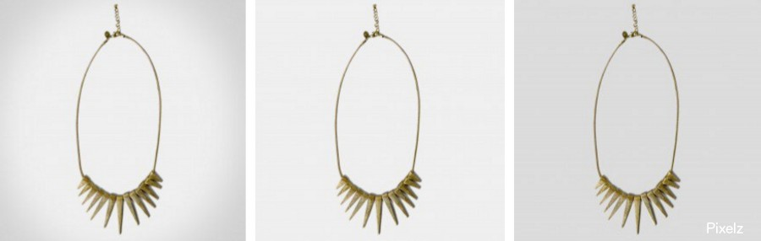
Crucial product photography mistakes
INCONSISTENT SHOOTING
Develop a set of guidelines for your photography and follow them. Consistency is key, and variations from product to product will distract your customer. Keep everything documented so you can resume shooting at any time with positive results.

Slide 12

Crucial product photography mistakes
DISTRACTING BACKGROUND
Some inexperienced retailers look at a white background and think “boring.” Trying to differentiate yourself with a colorful, active background is a huge mistake as it acts as a distraction for your customer.
Keep it neutral!

Slide 13
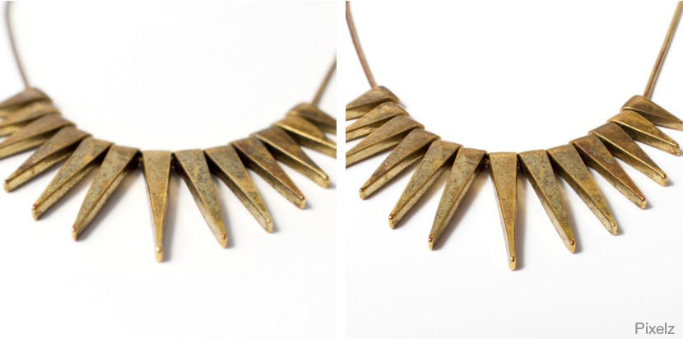
Crucial product photography mistakes
OUT OF FOCUS PHOTOS
Don’t take artsy low aperture shots of your jewelry that focus on only one part of the product. Make sure you are using full focus photography that will create a sharp image your customers can trust..

Slide 14
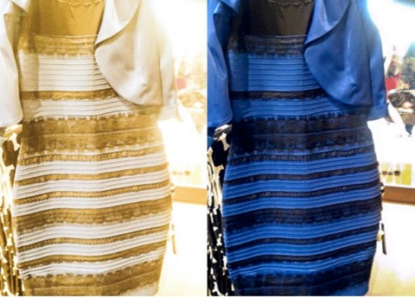
Crucial product photography mistakes
INACCURATE WHITE BALANCE
If your white balance is off, a gold image can look blue or vice versa. In case you needed a reminder, both dresses on the right are the exact same, sending the internet into a frenzy last year.

Slide 15
DIY product photography

Slide 16





What you’re going to need
Camera
Tripod
Table
Light
Foam board
White backdrop

Slide 17
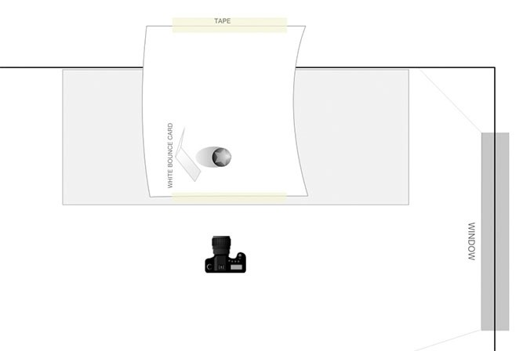
Step 1: Set up your table
Place your table as close to the window as possible without intersecting the shadow from the windowsill.
Start with the window 90 degrees to the right/left of your setup
The closer you are to the window, the softer the light will be
You do not want direct sunlight hitting your set

Slide 18
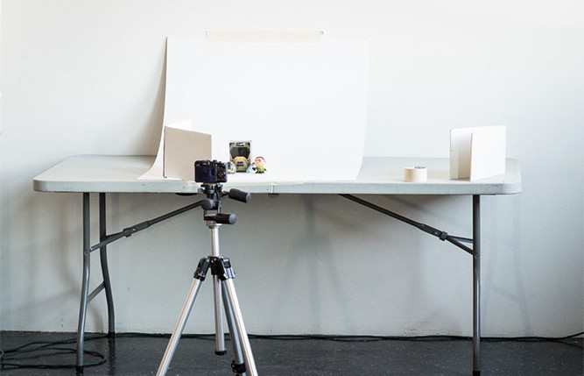
Step 2: Set up your sweep
Ultimate goal is to have your mat board sweep from being flat on your table to being vertical
You can place the table against the wall and tape the sweep to both the wall and the table
If you don’t have a wall, you will need to make something to secure the back of the sweep to (i.e bricks)

Slide 19
Step 3: Set up your product in the middle of the surface
May seem simple, but can take time to position correctly
Pay attention to all the little details, such as keeping the label type centred
Don’t be afraid of many tiny little movements!

Slide 20
Step 4: Set up the reflector card
The simple white card is the single most important light modifier to have
The light will bounce off the card and fill in all of the shadows
How you position this card is a matter of taste, so try it at all different angles!

Slide 21
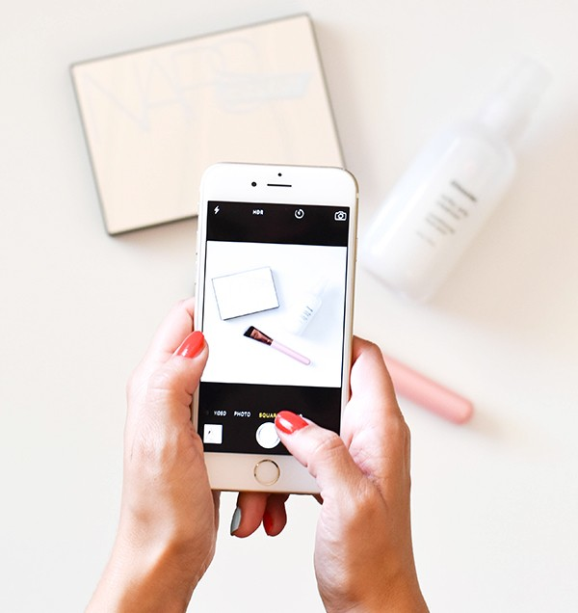
Step 5: Take the picture and evaluate
Once you snap the picture, take some time and really look at what you have created
Experiment with different ways of making your image better, and skills will improve over time
Upload your images onto your computer to see how they look

Slide 22
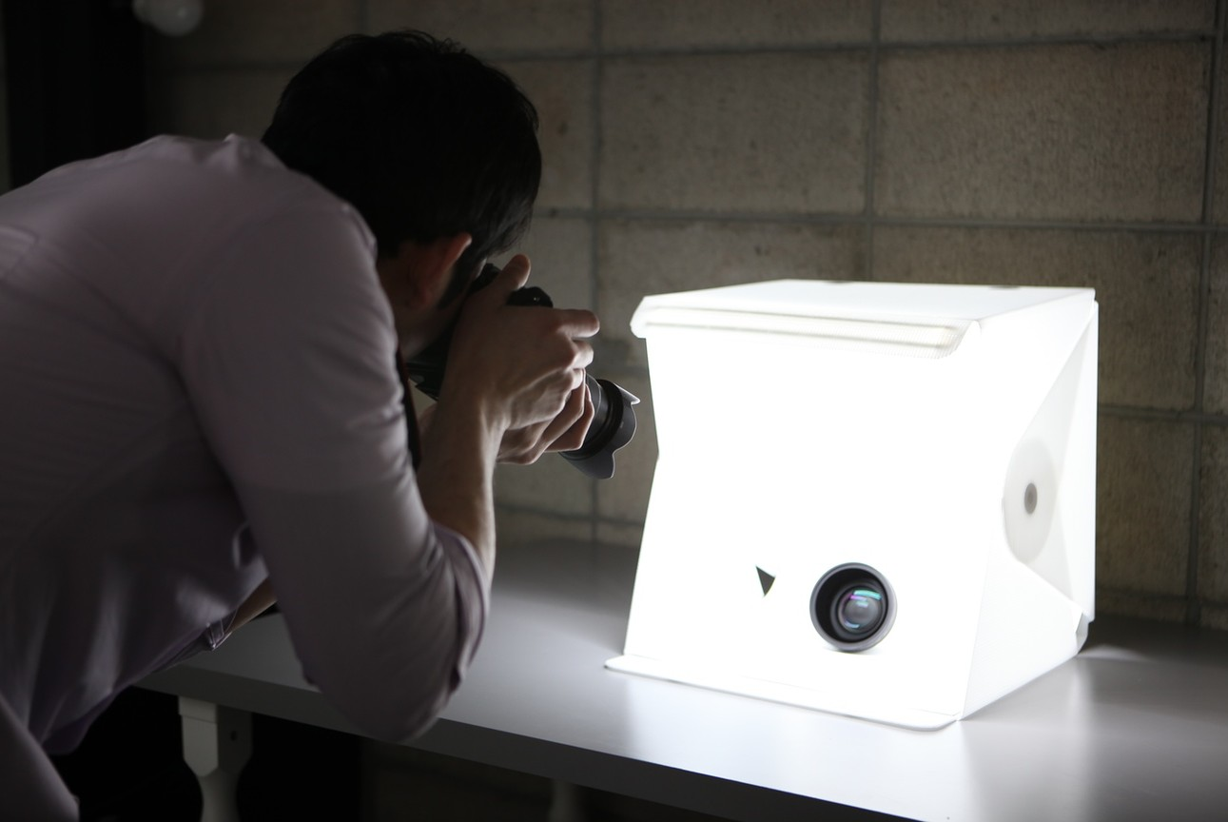
Foldable portable studio as an alternative
Foldable portable photography kit
Twin LED lights
Foldable and portable
Amazon or equivalent

Slide 23
Optimize your photos for the Web?

Slide 24
Optimize your photos for Shopify
REDUCE YOUR IMAGE FILE SIZES
Amazon found that if their pages slow down by 1 second, they would lose $1.6 billion a year. Every extra second spent loading a page could be losing valuable customers

Slide 25
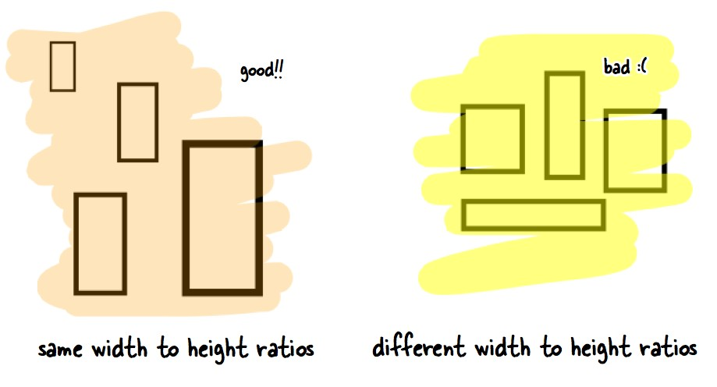
Optimize your photos for the web
KEEP IMAGE ASPECT RATIO CONSISTENT
Make sure all of your images maintain a consistent aspect ratio to create uniformity.
Making them all square is the easiest way around this, but you could do a rectangle as well, as long as it is consistent across the board

Slide 26
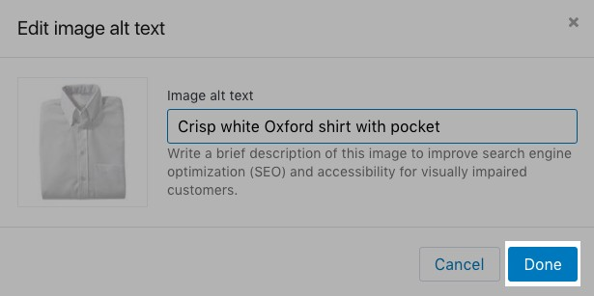
Optimize your photos for the web
ADD ALT TEXT TO ALL OF YOUR PHOTOS
Make sure all of your images maintain a consistent aspect ratio to create uniformity.
Making them all square is the easiest way around this, but you could do a rectangle as well, as long as it is consistent across the board

Slide 27
Consider
Instagram
A blog
Twitter
Facebook eBay
Amazon

