Slide 1
Macro Photography
There’s a whole new world waiting for you……

Slide 2
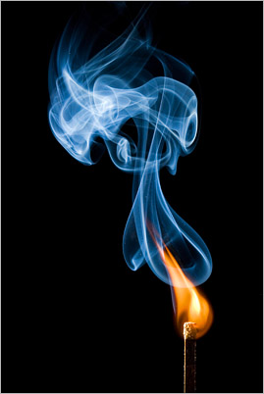
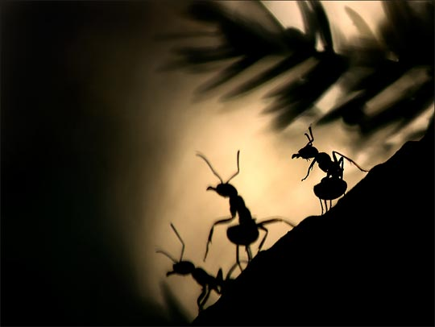
Macro Photography

Slide 3
Macro Photography

Slide 4
Macro Photography
Tobias high speed video

Slide 5
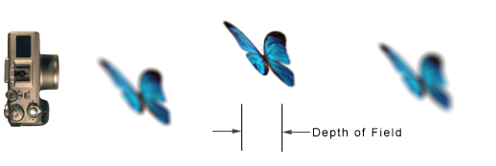
Depth of Field
Depth of Field is the area of an image that is in focus and extends in front of and behind the object
Macro photography has limited Depth of Field
The greater the magnification (how big the subject appears) the smaller the Depth of Field

Slide 6
Depth of Field
The Depth of Field covers a zone 1/3 in front of the focus point and 2/3 behind the focus point
In this eg. figures 1 and 5 will be out of focus
This ratio remains constant no matter how large the DOF is

Slide 7
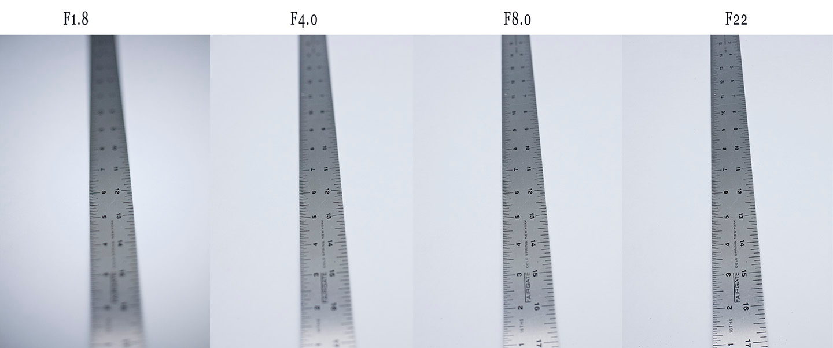
Depth of Field
DOF influenced by;
Aperture size (opening in lens)
Focal Length of the lens
Distance between the lens and the focus point

Slide 8
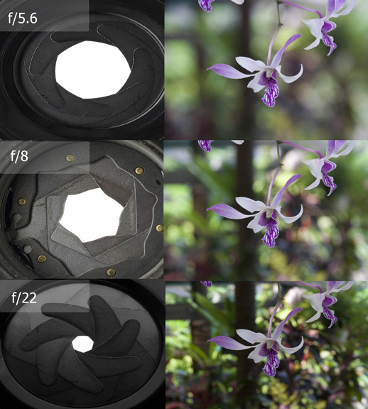
Depth of Field
Small or Shallow Depth of Field
Large or Deep Depth of Field

Slide 9
Lighting
Challenging to have sufficient lighting
Due to;
Macro photography requiring small apertures to achieve necessary Depth of Field
Macro photography requiring longer exposures to compensate for the small apertures
Flash generally used as it provides adequate light

Slide 10
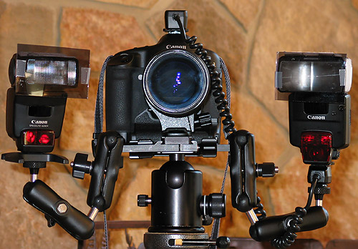
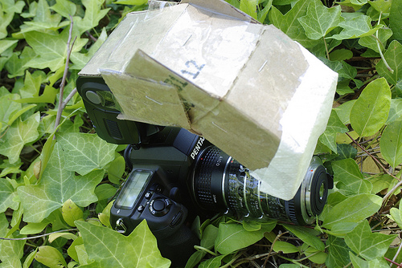
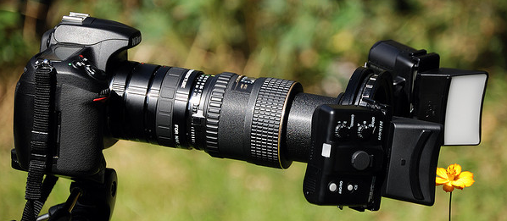
Lighting Rigs

Slide 11
Marvel at the small things!

