Slide 1
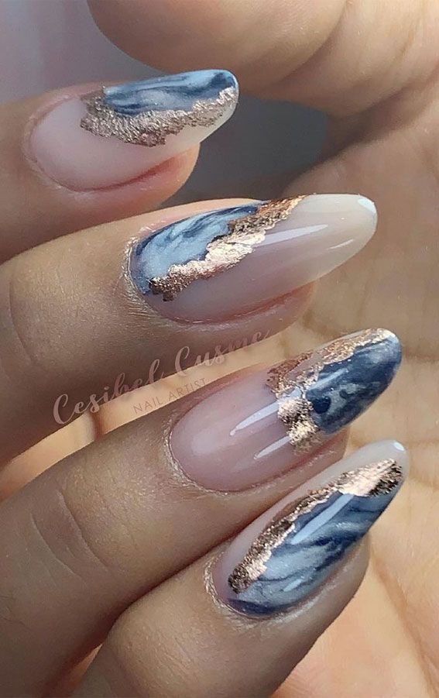
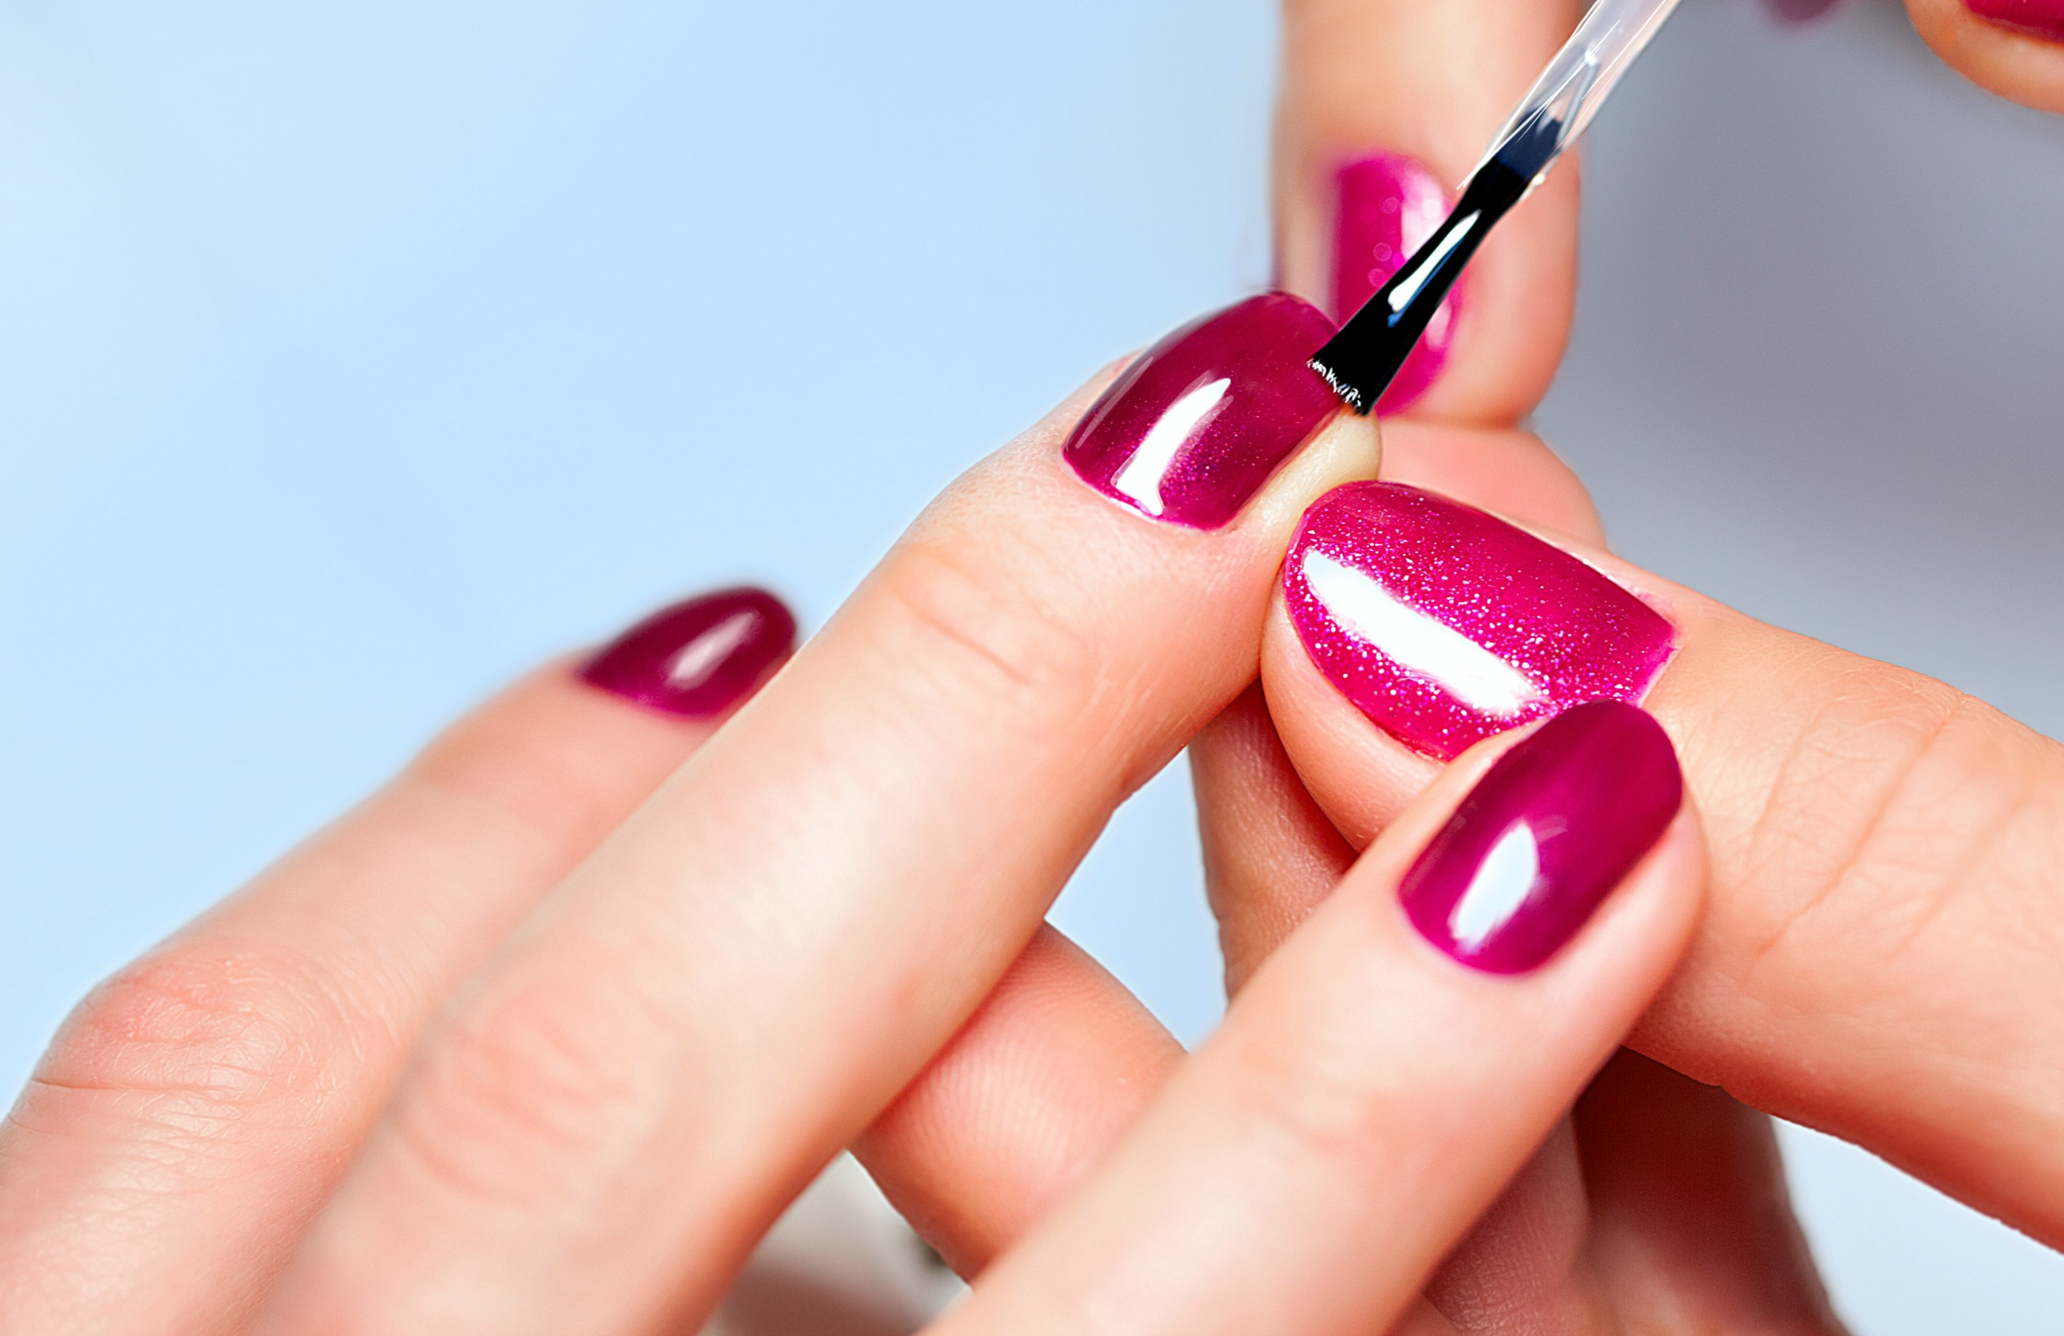
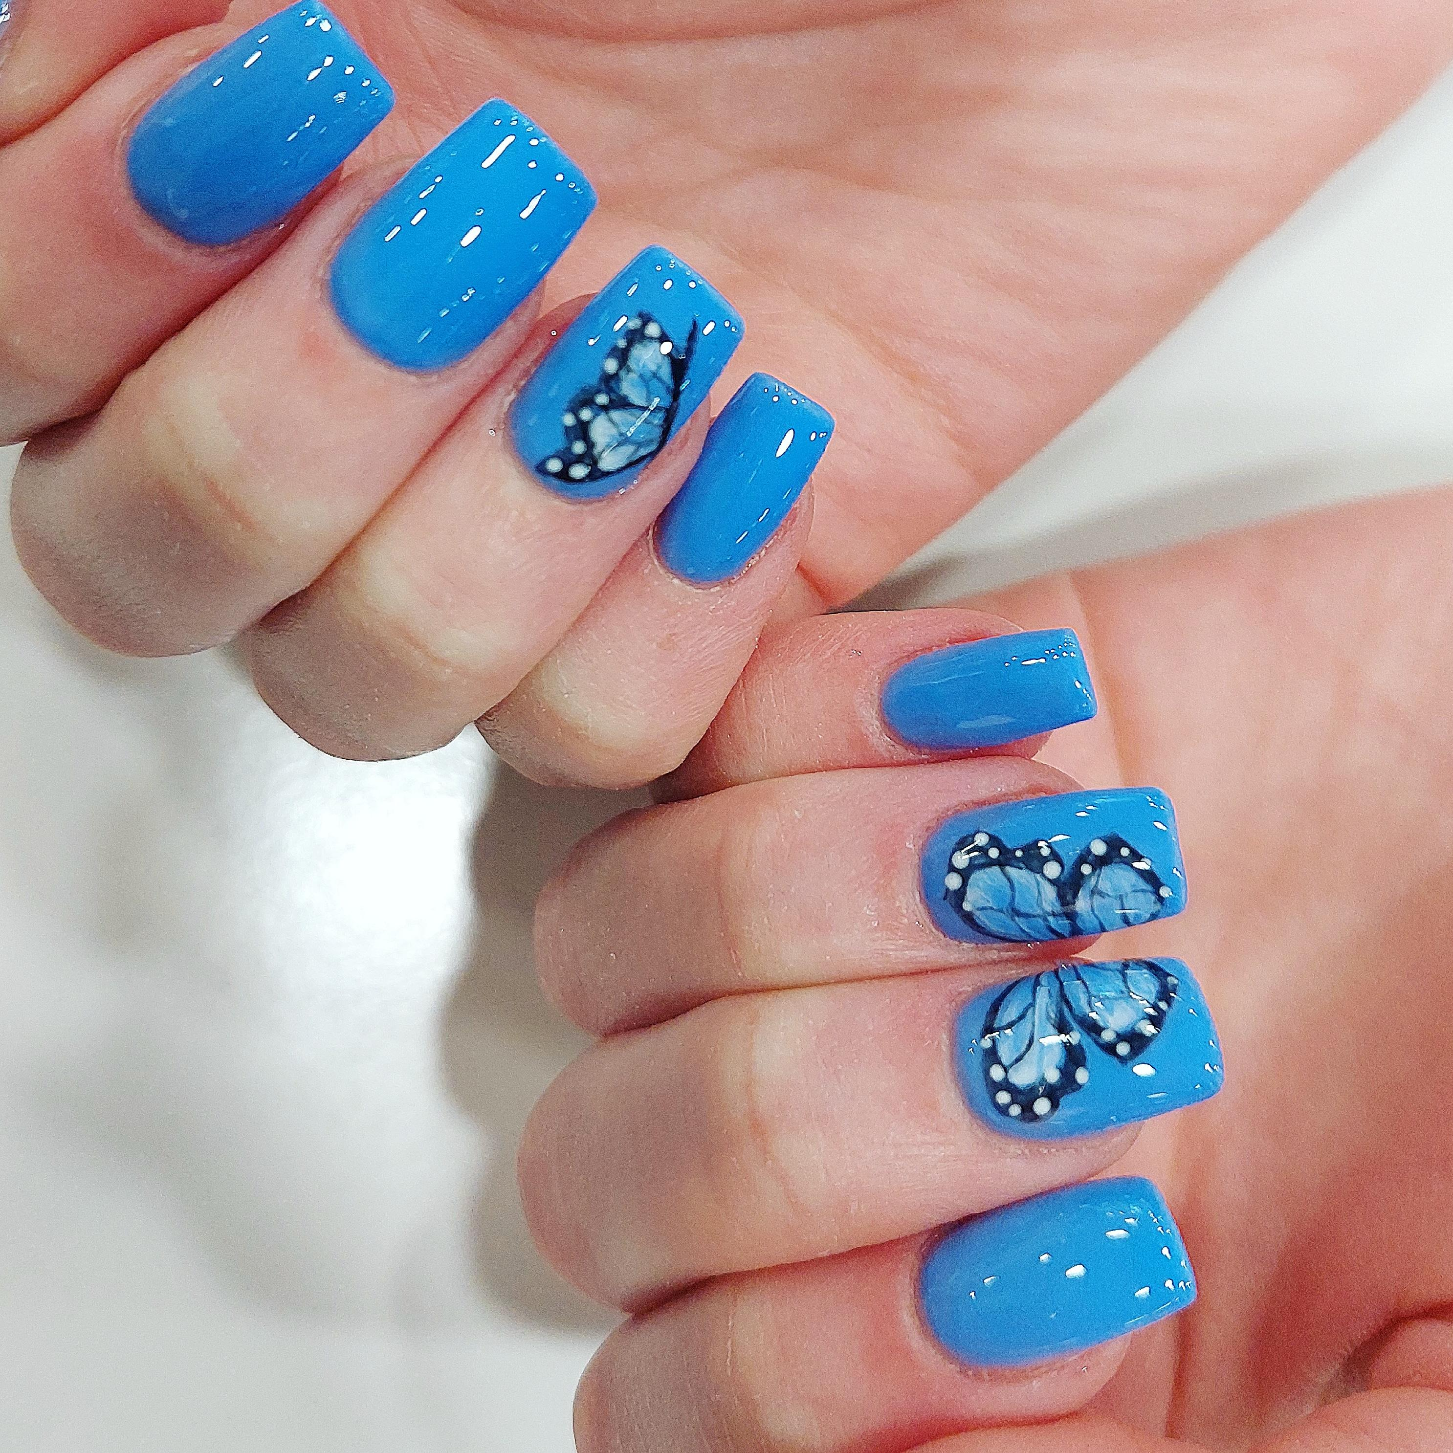
Nail Services
@ Cornwall College St Austell

Slide 2
Session Intent
Introduction to course and what to expect
Course overview
Timetables
Dress code/absence
Kits, uniform and stationary list
Work experience
EEP sessions
Summer Assignment
Questions

Slide 3
Assessment
Theory
No assignments
Written and Online exams
Practical
Build range
Practical assessments

Slide 4
Introduction to the course
Level 2 Nail Services
Units
G20 Ensure responsibility for actions to reduce risks to health and safety
G4 Fulfil salon reception duties
G18 Promote additional services or products to clients
G8 Develop and maintain your effectiveness at work
N2 Provide manicure services
N3 Provide pedicure services
N4 Carry out nail art services
N5 Apply and maintain nail enhancements to create a natural finish

Slide 5
Introduction to the course
Level 3 Nail Services
Units
G22 Monitor procedures to safely control work operations
N6 Enhance and maintain nails using UV Gel
N7 Enhance and maintain nails using liquid and powder
N8 Enhance and maintain nails using wraps
N9 Plan and create nail art designs
N10 develop a range of creative nail images
N12 Prepare and finish nail overlays using electric files
H32 Contribute to the planning and implementation of promotional activities

Slide 6
Timetables
Level 2 Nail Services
Monday | Tuesday | Wednesday | Thursday | Friday
English 9:00 – 10:30 Maths 10:45 – 12:15 | English 9:00 – 10:30 Maths 10:45 – 12:15 | Tutorial and PPD 9:00 – 10:30 Carmen Morcom Room: J478 Learning centre Theory 10:45 – 12:15 Carmen Morcom Room: J478 Learning centre |  | Work experience placement day
Lunch | Lunch | Lunch | Lunch | Lunch
Practical 13:00 – 16:15 Carmen Morcom Room: J473 | Practical 13:00 – 16:15 Carmen Morcom Room: J473 | Practical 13:00 – 16:15 Carmen Morcom Room: J473 |  | Work experience placement day

Slide 7
Timetables
Level 3 Nail Services
Monday | Tuesday | Wednesday | Thursday | Friday
Practical 9:00 – 12:15 Carmen Morcom Room: J473 | Practical 9:00 – 12:15 Carmen Morcom Room: J473 |  | Tutorial and PPD 9:00 – 10:30 Carmen Morcom Room: J478 Learning centre Theory 10:45 – 12:15 Carmen Morcom Room: J478 Learning centre | Work experience placement day
Lunch | Lunch | Lunch | Lunch | Lunch
English 13:00 – 14:30 Maths 14:45 – 16:15 | English 13:00 – 14:30 Maths 14:45 – 16:15 |  | Practical 13:00 – 16:15 Carmen Morcom Room: J473 | Work experience placement day

Slide 8
Kits and uniforms
Kits on display
Uniform order forms
Stationary items
Dress code

Slide 9
Work experience for Level 2
For all students 16-19yrs
Level 2 = 30 hours
Minimum one day a week Thursday, Friday or Saturday
Secure a placement ready for September
Work experience for level 3
For all students 16-19yrs
Level 3 = 60 hours
Minimum one day a week Friday or Saturday
Secure a placement ready for September

Slide 10
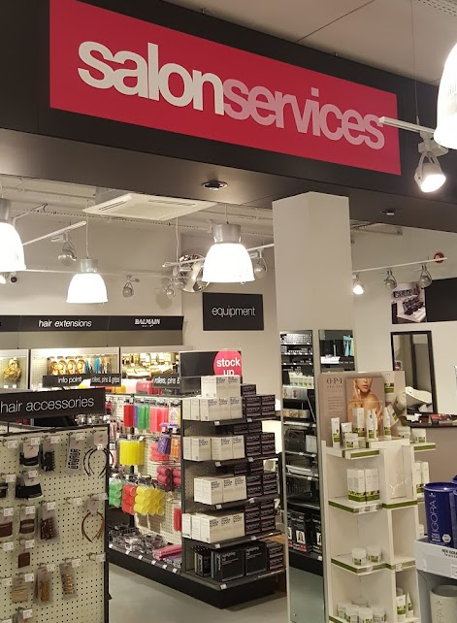
EEP sessions
Employability, Enrichment and Pastoral
Workshops and trips
End of year celebration
Preparation for industry and careers
Health and well being

Slide 11
Dress Code

Slide 12
Absence
Absentee procedure
100% attendance within first 42 days
95% for remainder of the year
Important!
Report absence before 9am
www.cornwall.ac.uk/absence
0330 123 2523

Slide 13
Level 2

Slide 14
Level 3

Slide 15
Questions
Any question for me?

